Slide 1
Remote Learning
Berry Pomeroy

Slide 2
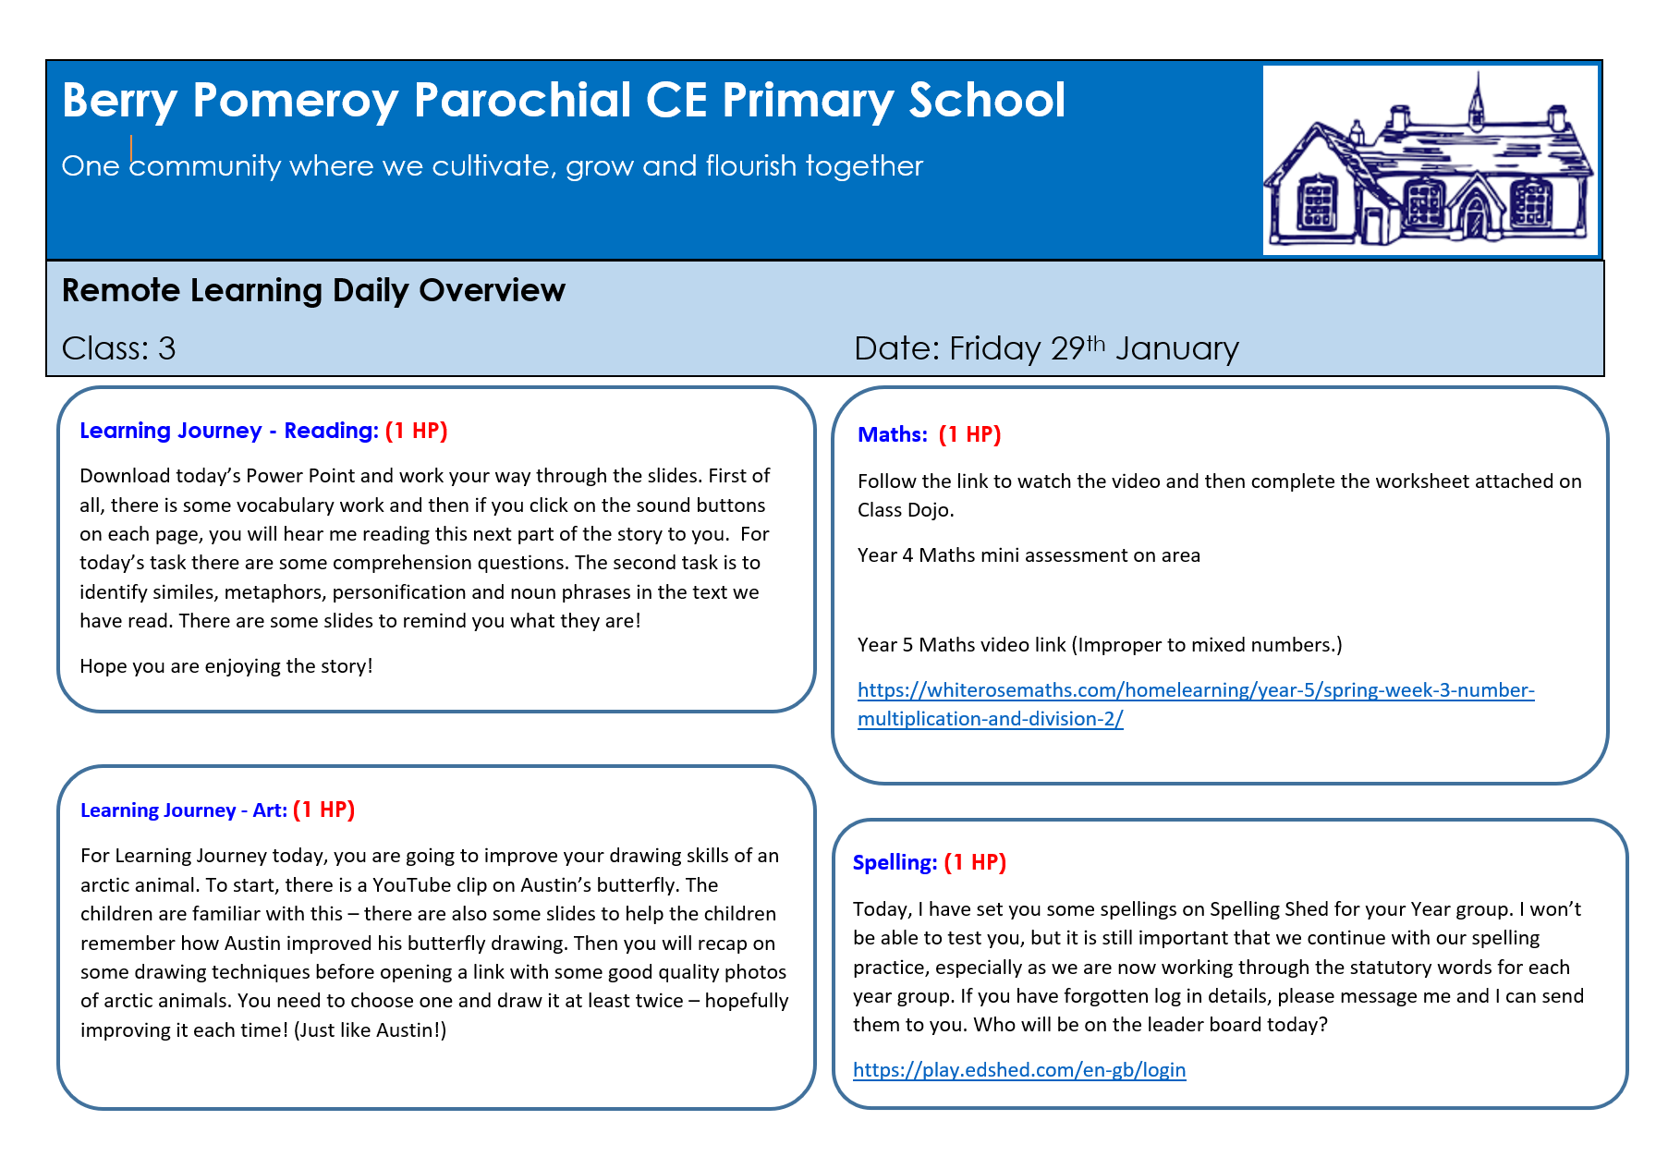
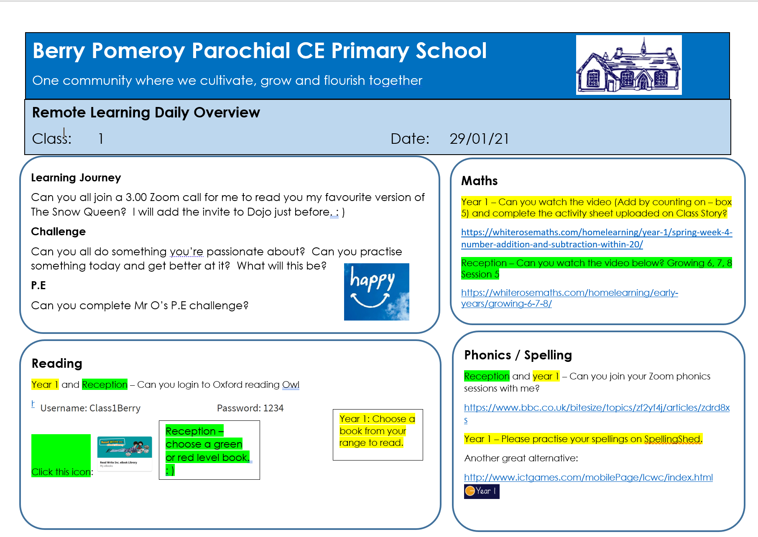
These are uploaded to Dojo the evening before
Remote Learning Template

Slide 3
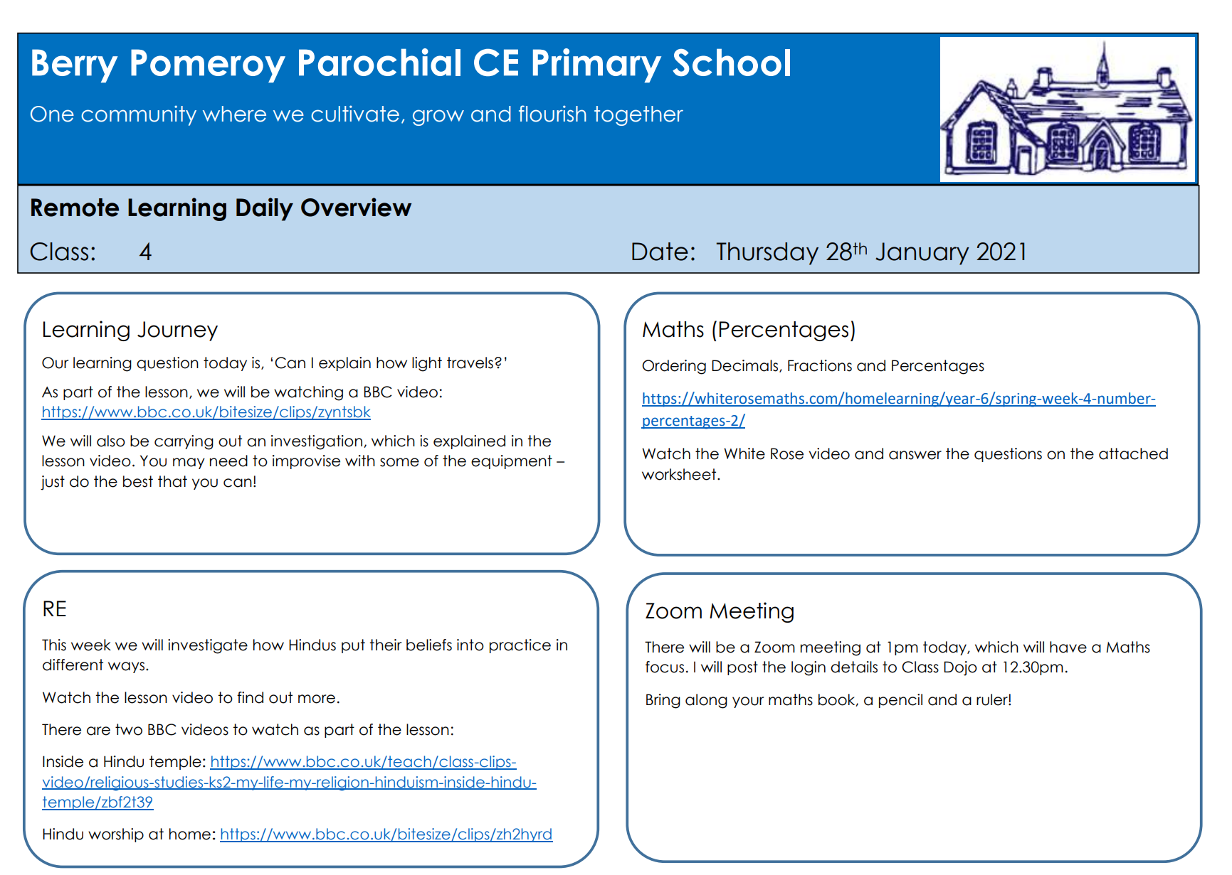
Remote Learning Template

Slide 4
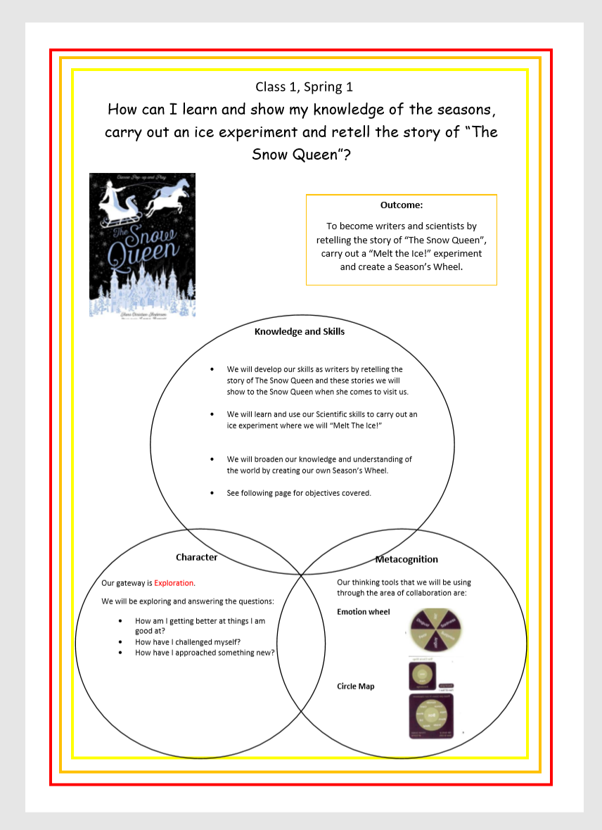
Learning Journey Front Cover
We are uploading our learning journey overviews to our Class Dojo pages so parent’s know the question and the objectives, including character and metacognition.
If parent’s have any questions around the 3 circles they are invited to ask questions through personal message. Teachers given time to support parent’s with curriculum content.

Slide 5
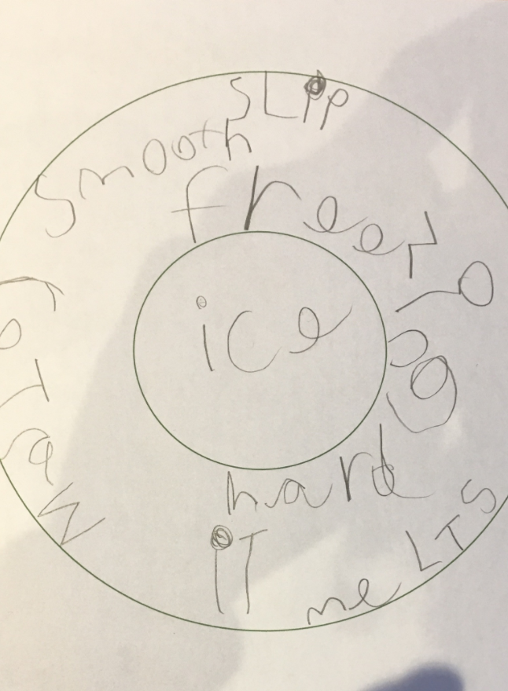
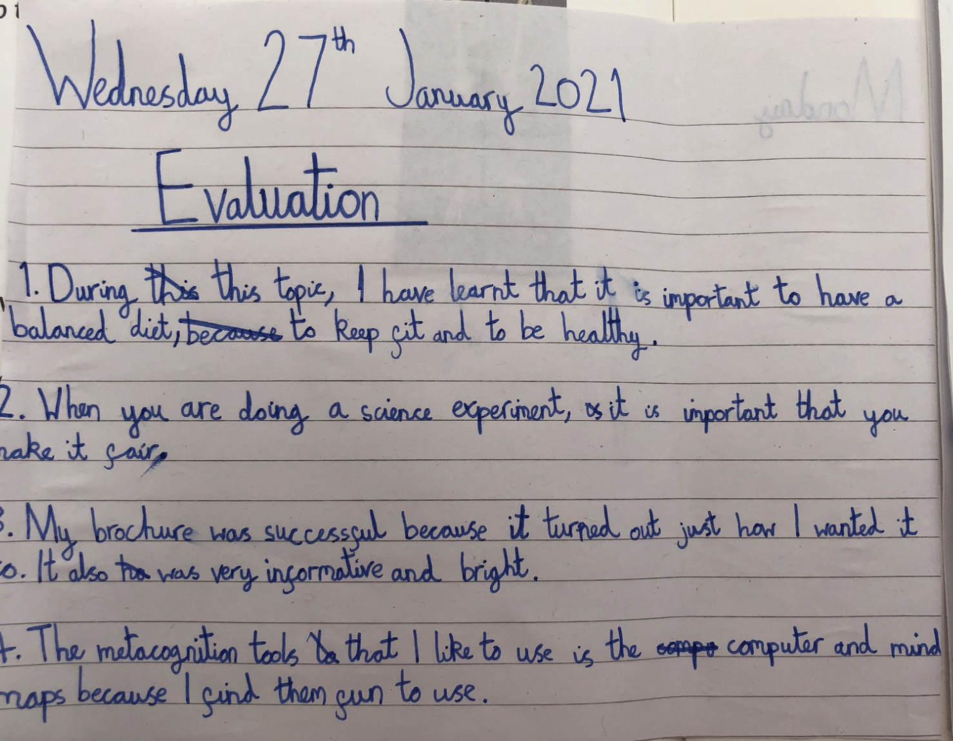
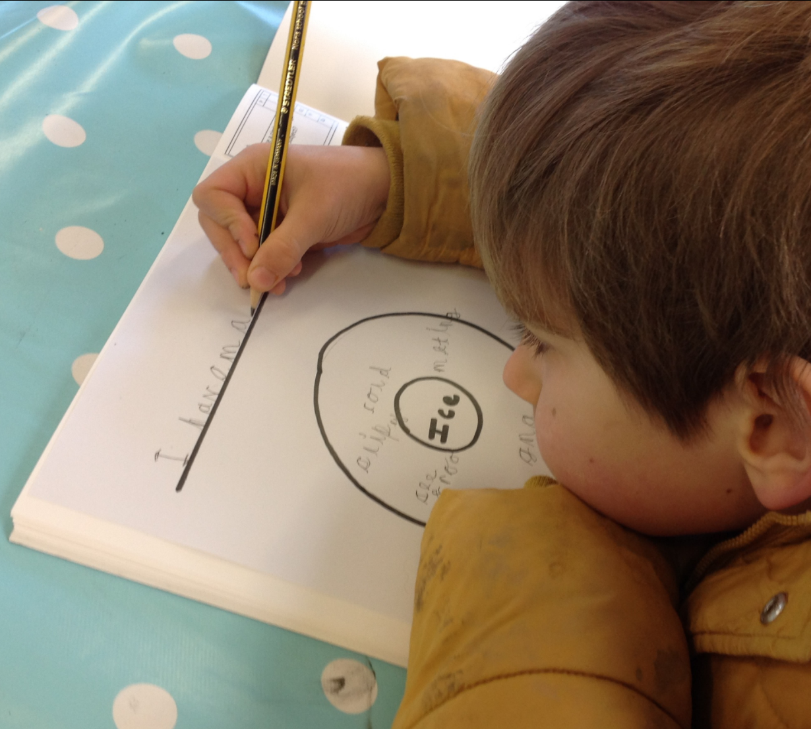
Metacognition
Home
Children are using the metacognition tools at school and home.
We are following the Learning Journeys we planned for Spring 1
School

Slide 6
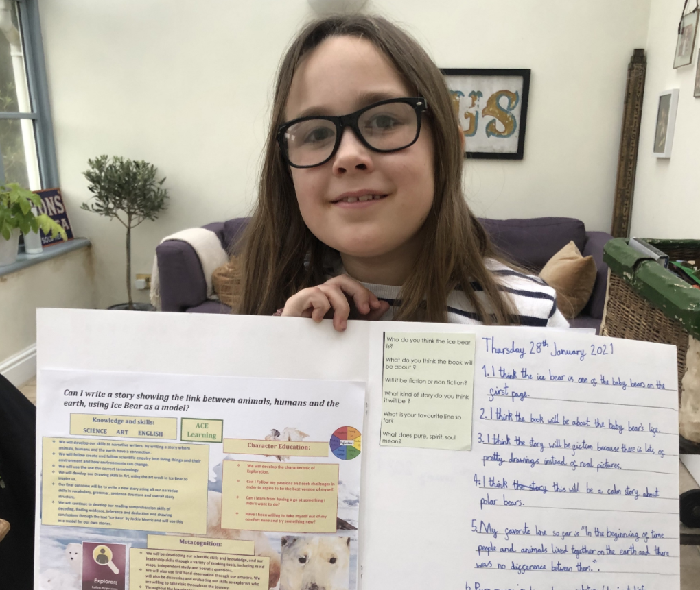
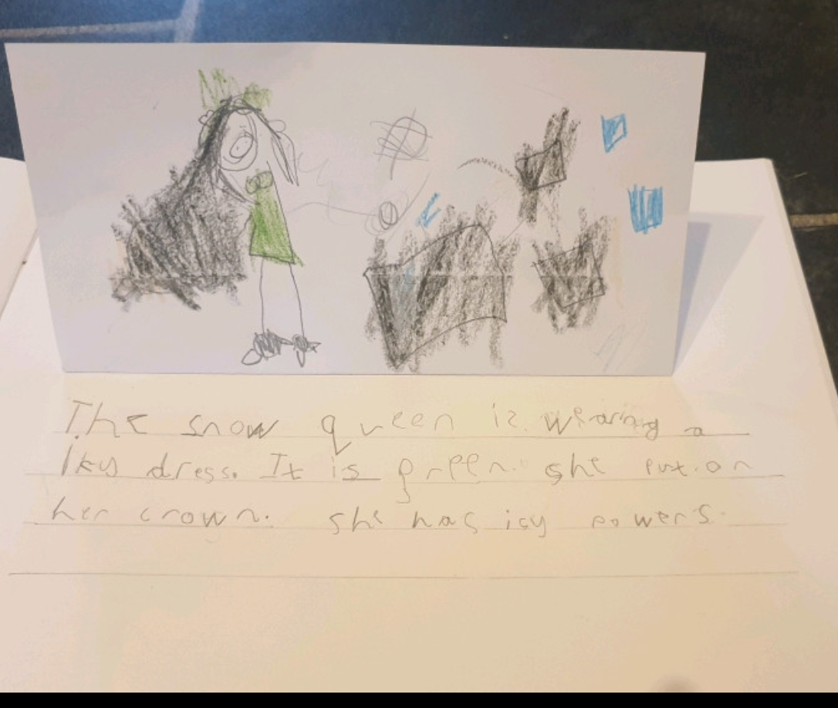
Learning Journals

Slide 7
Zoom

Slide 8
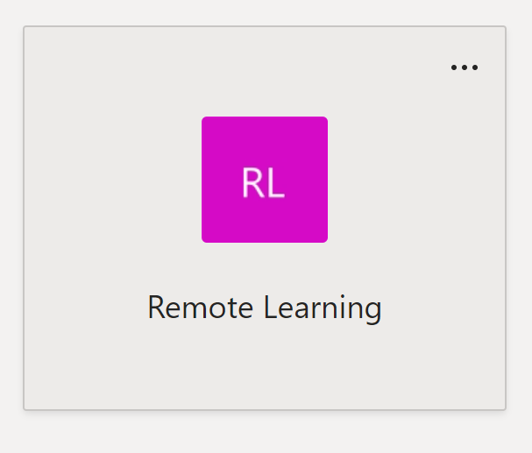
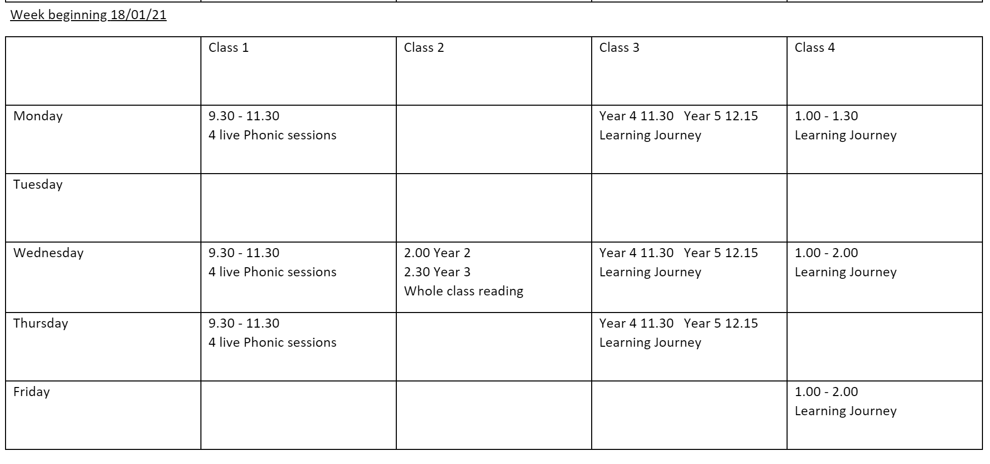
Zoom Session
We update our Zoom sessions on our Remote Learning Team so they do not clash and so I can monitor.
We provide a range of Zoom sessions across the week, for phonics, maths, learning journey and reading.
EYFS/KS1 phonics 5:1 with teacher 3 or 4 times a week.
Mr O (Saint Southwest) P.E challenge workshop every Friday – recorded video/zoom
1:1 Zoom sessions for catch up children either pre-teach or conferencing

Slide 9
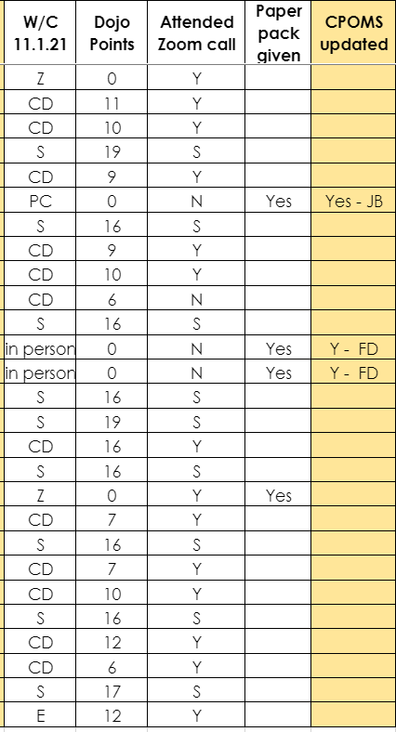
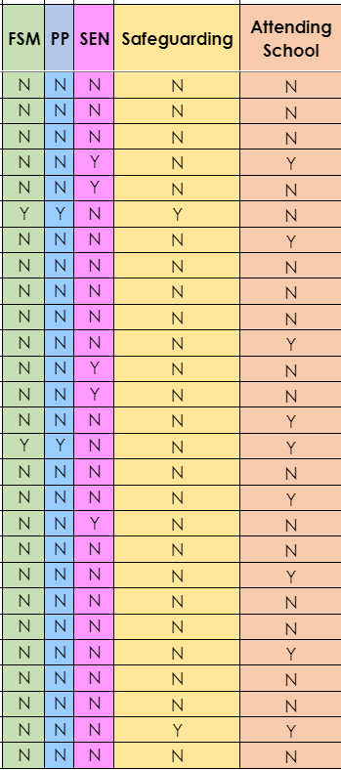
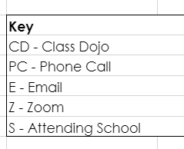
Monitoring Engagement
We monitor engagement through a document on our Team that we fill in each week
We also reset Dojo points each week to easily monitor level of engagement.
This document contains information about whether they are on our Safeguarding list, SEN or PP so we can carefully monitor these children.

Slide 10
Pupil Premium and Catch Up Children
Next week small group zoom sessions with teachers for our catch up children to work on intervention targets.
All Pupil Premium children are provided with reading books and a individual paper learning pack every week and appropriate resources – sound maths, maths resources. I phone call every week to ensure support given. We are going to also supply this for children on our catch up list

Slide 11
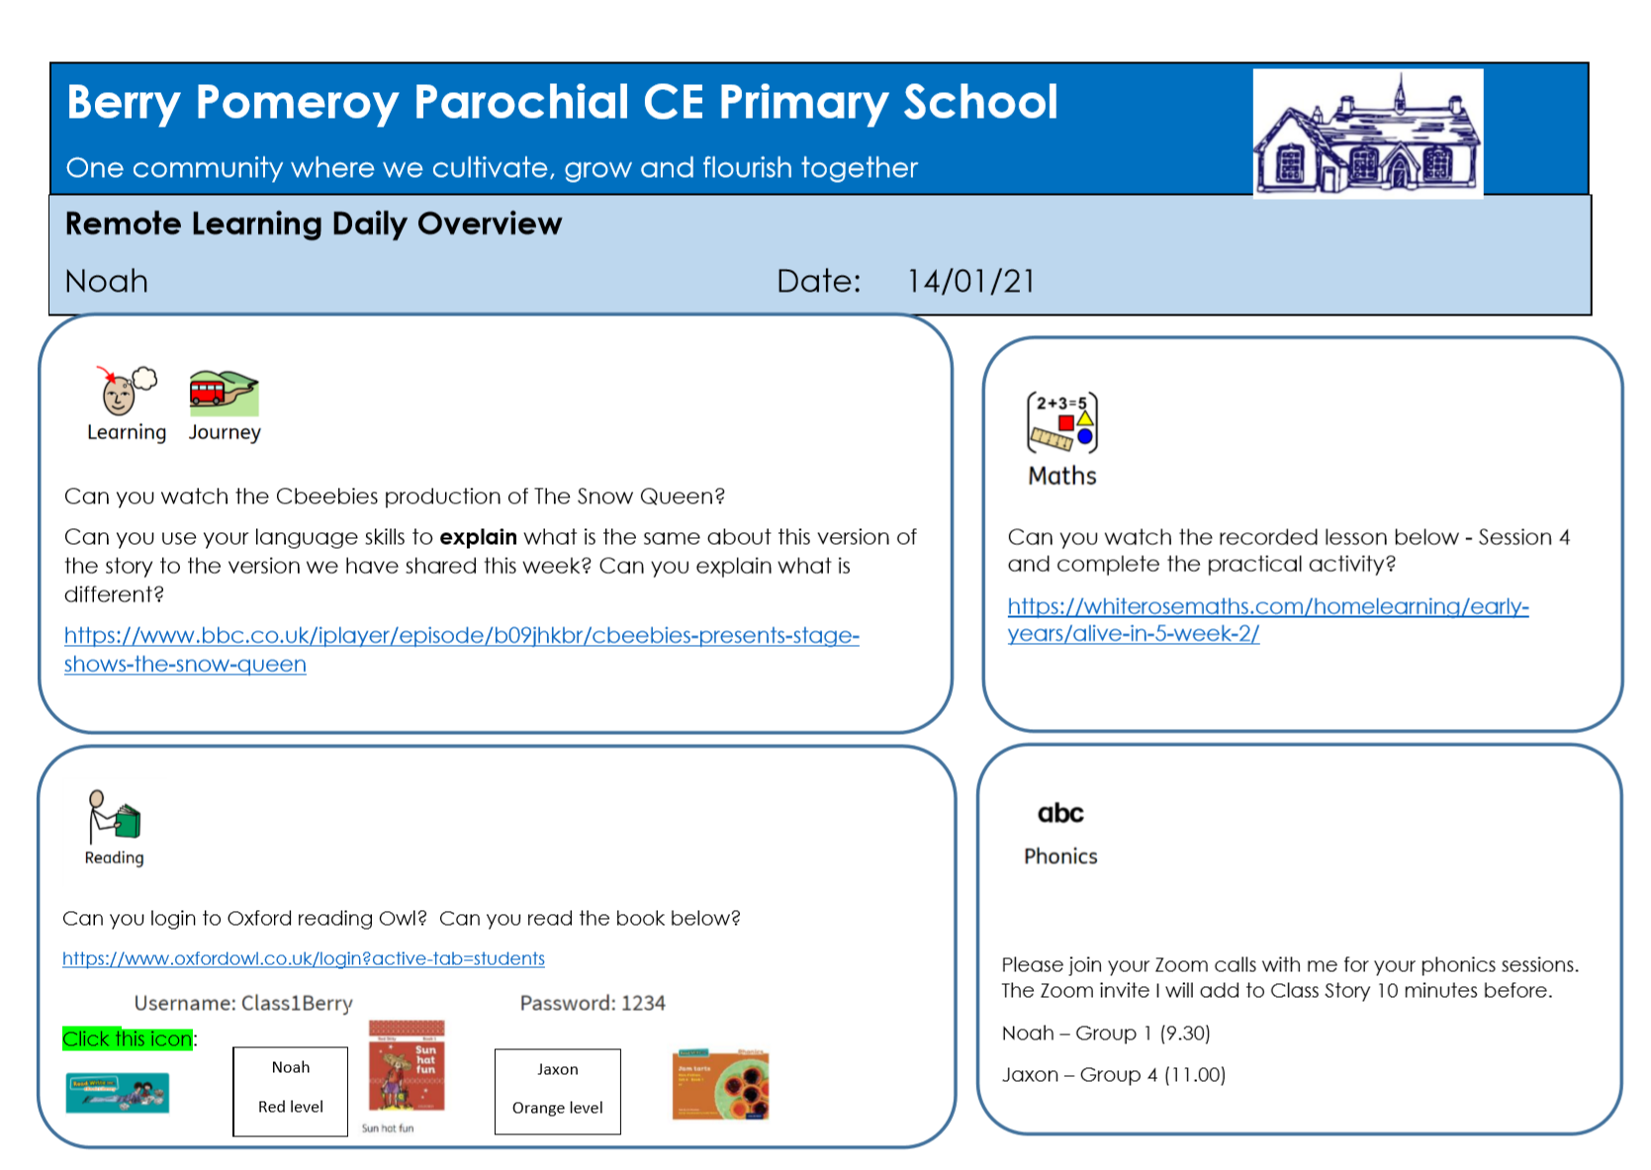
EHCP children learning at home
Our EHCP pupil who is learning at home is provided with his own Remote Learning Overview each day, based on his EHCP and ILP targets.
This child also has a 4:1 Zoom session each day, working on his phonics.
Going forward he is also going to have a 1:1 number zoom session each week with his teacher.

Slide 12
Character Education
Every week I upload an assembly based on character education to all class pages and give children a challenge for the week based on this character value.
Weekly Worship assembly based on gateway themes.

Slide 13
Reading
All Pupil Premium and catch up children are provided with reading books.
We have written a reading letter for parent’s to show them how they can access reading books at home and to contact us if any problems and we will support.
Children are able to access their A.R quizzes at home and this is monitored.
KS1 children are using Oxford Owl to access their Read Write Inc reading books at correct level.
There is a reading task set every day.
Many recorded sessions are teachers reading their class text.

Slide 14
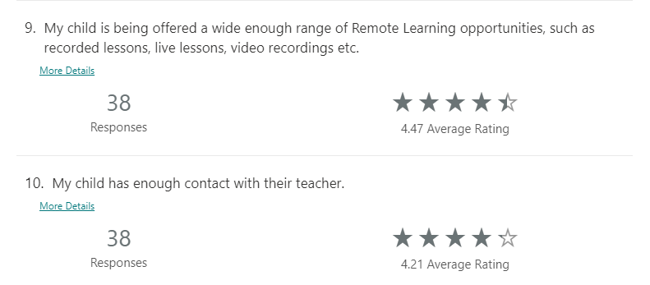
Remote Learning Questionnaire

Slide 15
Remote Learning Feedback
We've found the zoom sessions fantastic as it's encouraged the children to learn as they see Mrs Bowden daily . This interaction has helped with all the other home learning, as they are now keen to learn rather than be reluctant learners! We've got into a great routine now, which helps our work and home schooling balance. Thank you!
My son is really enjoying the live zoom classes and after we both enjoy spending time doing the home learning together
My child attends 3 days each week at school and one day with a grandparent so I am only required to manage remote learning one day each week. I feel that class dojo works well for us and we have no issues with how the work is set or the amount, all the teachers at Berry are doing a marvellous job!
I think the teachers are providing great support and it’s much appreciated.
Thank you to all the staff for their continued hard work, and supplying all we need for remote learning. Communication is great and we feel fully supported.
Thank you to all the staff for their continued hard work, and supplying all we need for remote learning. Communication is great and we feel fully supported.
Thank you to all the staff for all their hard work, and supplying all we need for remote learning. Communication is great and we feel fully supported.
Mrs While has been very supportive throughout.

